Slide 1
Process Management
Process Scheduling
Lecture 3 (Live Version)

Slide 2
Overview
Concurrent Execution
Process Scheduling
  Definition
  Process behavior
  Processing environment
  Criteria for good scheduling
  Procedure of process scheduling
Scheduling Algorithms
  For interactive System
  For real-time systems

Slide 3
Concurrent Execution
Concurrent processes:
  Logical concept to cover multitasked processes
  Could be virtual parallelism
  Could be physical parallelism
You can assume the two forms of parallelisms are not distinguished in the following discussion

Slide 4

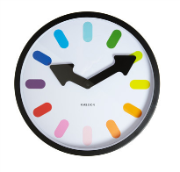
Concurrency Example (Simplistic)
Timeslicing
Process
A
a1 a2
a3
a4 a5 a6
b1 b2 b3
b4 b5
B
Time
t1
t2
t3
Notes:
Mention OS here

Slide 5
Interleaved Execution (context switch)
Context Switch
Process
A
a1 a2
a3
a4 a5 a6
b1 b2 b3
b4 b5
B
OS
Time
t1
t2
t3
Notes:
Tux pic

Slide 6
Multitasking OS
1 CPU: timesliced execution of tasks
p1
p2
p3
CPU
Multiprocessor: timeslicing on n CPUs
CPU 1
p1
p3
CPU 2
p2
p4

Slide 7
Scheduling in OS: A definition
Problems with having multiple processes:
  If [ready-to-run processes] > [CPUs], which should be chosen?
    Similar idea in thread-level scheduling
  Known as the scheduling problem
Terminology:
  Scheduler
    Part of the OS that makes scheduling decision
  Scheduling algorithm
    The algorithm used by scheduler

Slide 8
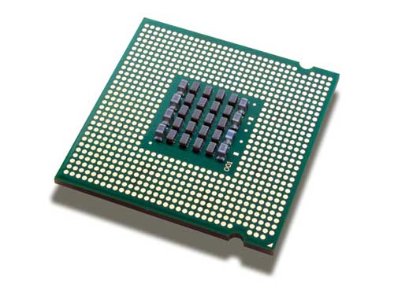
Scheduling: Illustration
selects process
Scheduler
allocates cpu
Processes ready to run
Each process has different requirement of CPU time
  Process behavior
Multiple ways to allocate
  Influenced by the process environment
  Known as scheduling algorithms
A number of criteria to evaluate the scheduler

Slide 9
3 Types of Processing Environment
Batch Processing:
  No user: No interaction required, No need to be responsive
  Not considered here.
Interactive (or Multiprogramming):
  With active user interacting with system
  Should be responsive, consistent in response time
Real time processing:
  Have deadline to meet
  Usually periodic process

Slide 10
Criteria for Scheduling Algorithms
Many criteria to evaluate an scheduling algorithm
Criteria for all processing environments:
Fairness:
  Should get a fair share of CPU time
    per process basis OR
    per user basis
  Also mean no starvation
Balance:
  All parts of the computing system should be utilized

Slide 11
When to perform scheduling?
Two types of scheduling policies
Non-preemptive (Cooperative)
  A process stayed scheduled until:
  it blocks OR
  give up the CPU voluntarily
Preemptive
  A process is given a fixed time quota to run
    Possible to block or give up early
  At the end of the time quota:
    Another process get picked if available

Slide 12
Scheduling a Process: Step-by-Step
1
2
3
4
5
If Context switch is needed:
Pick a suitable process P to run base on scheduling algorithm
Setup the context for P
Let process P run
Scheduler is triggered ( OS takes over )
Context of current running process is saved and placed on blocked queue / ready queue

Slide 13
Scheduling for
Interactive Systems

Slide 14
Criteria for interactive environment
Response time:
  Time between request and response by system
Predictability:
  Variation in response time, lesser variation == more predictable
Preemptive scheduling algorithms are used to ensure good response time
  ➔ Scheduler needs to run periodically

Slide 15
Ensuring Periodic Scheduler
Questions:
  How can the scheduler "take over" the CPU periodically?
  How can we ensure the user program can never stop the scheduler from executing?
Ingredients for answer:
  Timer interrupt = Interrupt that goes off periodically (based on hardware clock)
  OS ensure timer interrupt cannot be intercepted by any other program
  ➔ Timer interrupt handler invokes scheduler

Slide 16
Terminology: Timer & Time Quantum
Interval of Timer Interrupt:
  OS scheduler is triggered every timer interrupt
  Typical values (1ms to 10ms )
Time Quantum:
  Execution duration given to a process
  Could be constant or variable among the processes
  Must be multiples of interval of timer interrupt
  Large range of values (commonly 5ms to 100ms)

Slide 17
Illustration: ITI vs Time Quantum
Interval of Timer Interrupt = 10ms
Time Quantum = 20ms
Interval of Timer Interrupt = 10ms
Time Quantum = 40ms

Slide 18
Scheduling Algorithms:
Algorithms covered:
  Round Robin (RR)
  Priority Based

Slide 19
Round Robin: RR
General Idea:
  Tasks are stored in a FIFO queue
  Pick the first task from queue front to run until:
    A fixed time slice (quantum) elapsed
    The task gives up the CPU voluntarily
    The task blocks
  The task is then placed at the end of queue to wait for another turn
    Blocked task will be moved to other queue to wait for its request
  When blocked task is ready again, it is placed at the end of queue

Slide 20
Round Robin: RR (cont)
Notes:
  Basically a preemptive version of FCFS
  Response time guarantee:
    Given n tasks and quantum q
    Time before a task get CPU is bounded by (n-1)q
  Timer interrupt needed:
    For scheduler to check on quantum expiry
  The choice of time quantum duration is important:
    Big quantum: Better CPU utilization but longer waiting time
    Small quantum: Bigger overhead (worse CPU utilization) but shorter waiting time

Slide 21
Round Robin: Illustration
Execution Timeline
A: 2 TUs
A: 2 TUs
A: 1 TU
B: 2 TUs
B: 2 TUs
B: 2 TUs
C: 2 TUs
C: 1 TUs

Slide 22
Priority Scheduling
General Idea:
  Some processes are more important than others
    Cannot treat all process as equal
  Assign a priority value to all tasks
  Select task with highest priority value
Variants:
  Preemptive version:
    Higher priority process can preempts running process with lower priority
  Non-preemptive version:
    Late coming high priority process has to wait for next round of scheduling

Slide 23
Priority Scheduling: Illustration
Tasks
Arrival Time
Priority (1=highest)
A: 8 TUs
Time 0
3
C: 3 TUs
Time 1
1
B: 5 TUs
Time 1
5

Slide 24
Priority Scheduling: Shortcomings
Low priority process can starve:
  High priority process keep hogging the CPU
  Worse in preemptive variant
Possible solutions:
  Decrease the priority of currently running process after every time quantum
  Give the current running process a time quantum
Hard to guarantee or control the exact amount of CPU time given to a process using priority

Slide 25
Scheduling for real-time systems

Slide 26
Scheduling Algorithms:
Algorithms covered:
  Fixed Priority Scheduling
  Rate Monotonic Scheduling (RMS)
  Earliest Deadline First Scheduling (EDF)

Slide 27
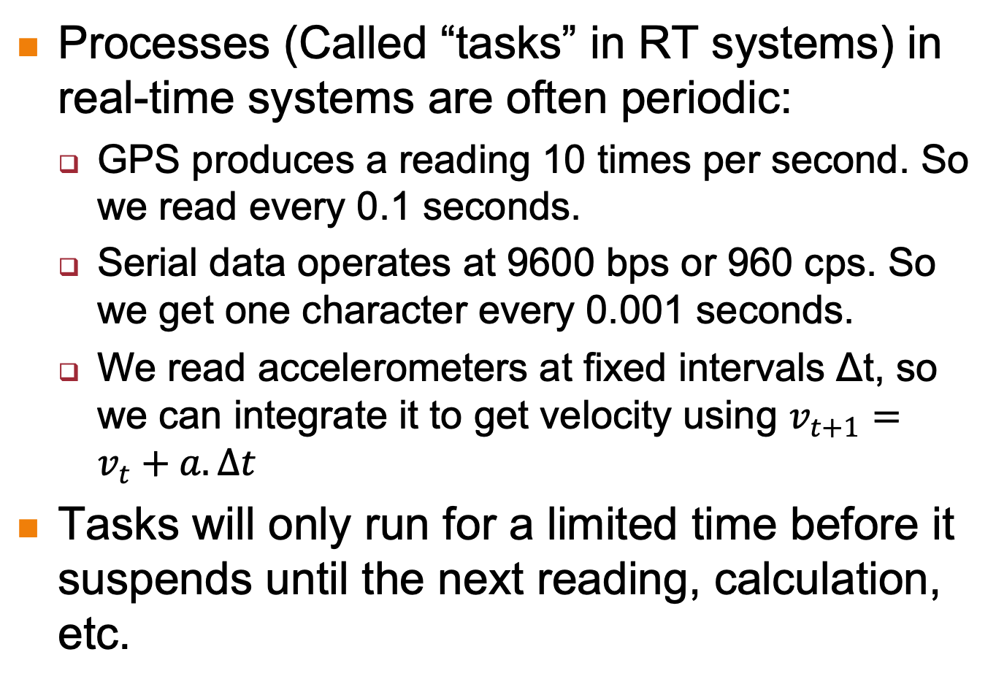
Real-Time Systems: Special Characteristics
Processes (Called “tasks” in RT systems) in real-time systems are often periodic:
  GPS produces a reading 10 times per second. So we read every 0.1 seconds.
  Serial data operates at 9600 bps or 960 cps. So we get one character every 0.001 seconds.
  We read accelerometers at fixed intervals Δt, so we can integrate it to get velocity using $v_{t+1}=v_{t}+a.∆t$
Tasks will only run for a limited time before it suspends until the next reading, calculation, etc.

Slide 28
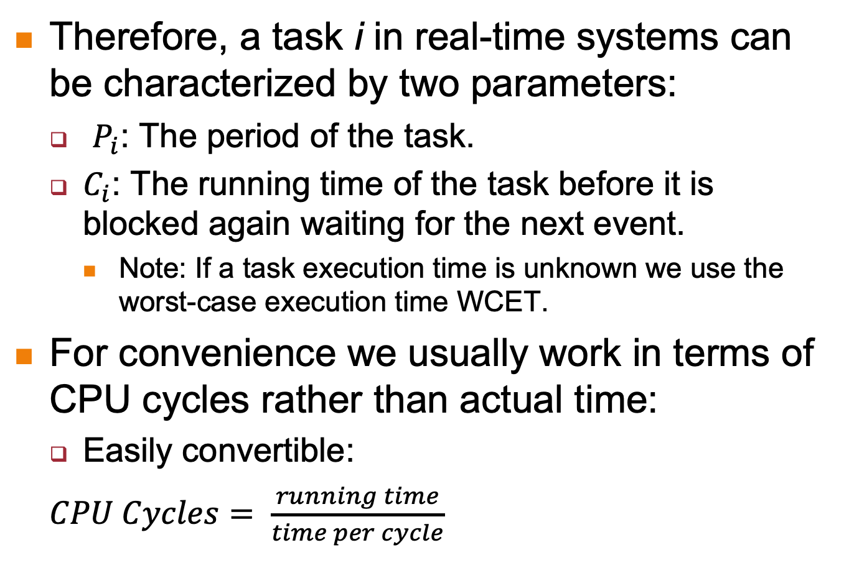
Real-Time Systems: Special Characteristics
Therefore, a task i in real-time systems can be characterized by two parameters:
  $P_{i}$: The period of the task.
  $C_{i}$: The running time of the task before it is blocked again waiting for the next event.
    Note: If a task execution time is unknown we use the worst-case execution time WCET.
For convenience we usually work in terms of CPU cycles rather than actual time:
  Easily convertible:
  $CPU Cycles= \frac{running time}{time per cycle}$

Slide 29
Fixed Priority Scheduling
In Fixed Priority, each task is manually assigned a priority.
  Higher priority tasks are picked first.
  If a higher priority task becomes ready, it pre-empts the lower-priority task.
    Works the same way that we saw earlier, except that tasks are periodic, and run for a fixed time before becoming blocked until the next period.
    All tasks are ready at time t0.
Note: In all cases we assume that the scheduler is pre-emptive.

Slide 30
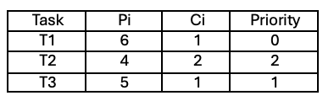
Fixed Priority Scheduling
We have the following set of 3 tasks with the periods and running times shown in CPU cycles.
  Lower priority number = higher priority.

Slide 31
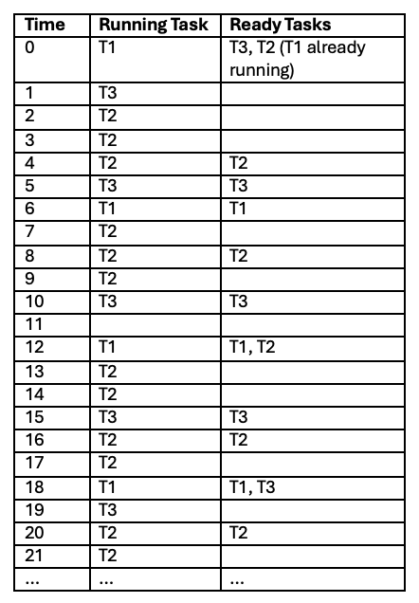
Fixed Priority Scheduling
We can get the schedule as shown:

Slide 32
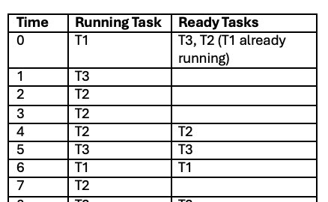
Deadlines
Deadlines are important in real-time scheduling:
  A task must generally finish running before it is due to run again.
    Remember: The periods correspond to when new data arrives.
    We assume that we lose the previous data if we don’t finish running before the next data comes.
      Deadline for T2 shown below. Deadlines for T1 and T3 follow the same idea.
Deadline for previous run of T2

Slide 33
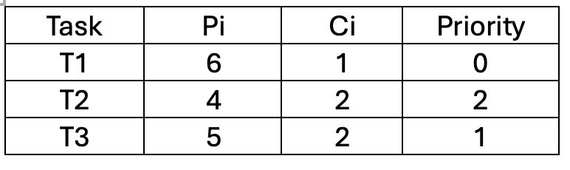
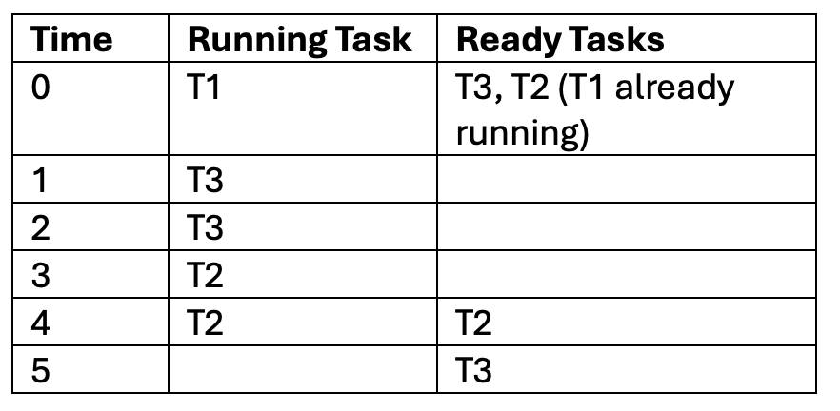
Missed Deadlines
Consider the following task characteristics.
We get the following schedule:
1. This is from the first run of T2
2. The run of T2 cannot complete before the next time it is due to run. Missed deadline!

Slide 34
Missed Deadlines
If we can schedule a series of tasks so that they can all meet their deadlines, we say that the tasks are “schedulable”.
  In our earlier example, there may be a different ordering of priorities where all tasks meet their deadlines.
Challenge: How do we find this optimal assignment of priorities?

Slide 35
Rate Monotonic Scheduling: RMS
One solution:
  Prioritize according to period.
    Shorter period = higher priority.
  Rationale:
    Tasks with shorter periods are likelier to miss their deadlines
    Thus, we let them run first.
This way of scheduling is called “Rate Monotonic Scheduling”
  RMS produces the optimal assignment of priorities.

Slide 36
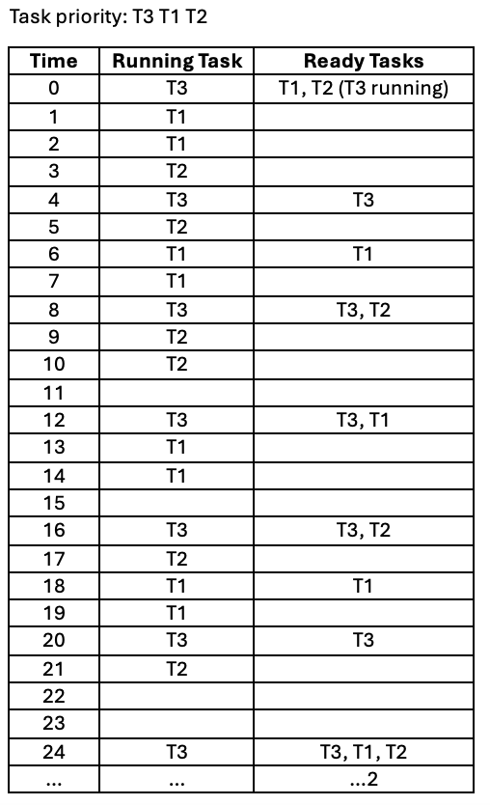
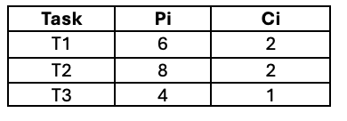
RMS Example 1
We consider the schedule for this set of tasks:

Slide 37
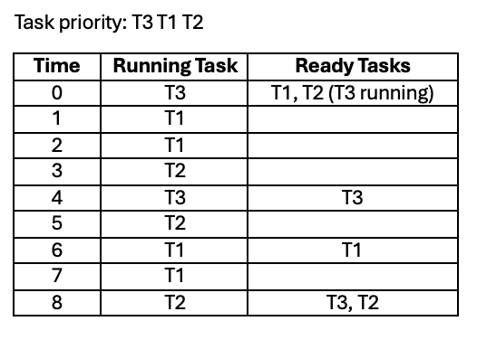
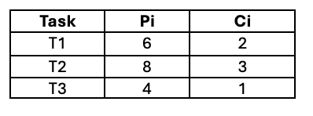
RMS Example 2
Since RMS is optimal, does this mean that tasks (at least those that don’t overload the CPU) are always schedulable?
Consider the case that T2 now takes 3 cycles instead of 2:
Missed Deadline

Slide 38
Testing Schedulability
Most obvious way: “unroll” the schedule until it repeats.
  The schedule will repeat after the ”hyper-period”, which is the lowest-common-multiple of all the periods.
  In our example:
    LCM(4, 6, 8) = 24
    So, our unrolling is complete. First example is schedulable.
Tedious, and sometimes impractical.
  E.g. LCM(3, 7, 11) = 231 – Need to compute 231 rows!

Slide 39
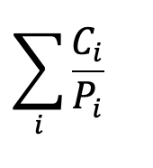

CPU Utilization
CPU Utilization is the percentage of time that the CPU is being used.
For periodic processes, this is given by:
CPU utilization of our two RMS examples:
  Example 1 = 2/6 + 2/8 + 1/4 = 0.83
  Example 2 = 2/6 + 3/8 + 1/4 = 0.96
In all scheduling algorithms, it is necessary that

Slide 40

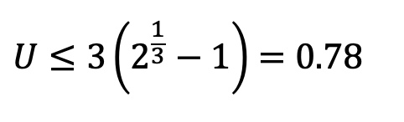
Utilization Bound
We can test RMS schedulability by using the Liu and Leyland bound:
  A set of tasks is schedulable under RMS if:
  In our example, n = 3, so we need:
  Note how RMS example 1 U = 0.83 > 0.78, but it is schedulable.
    Liu and Leyland is a sufficient but not necessary condition.

Slide 41

Utilization Bound
Common Liu and Leyland bounds:
If U is less than or equal to the bound for the number of tasks, we do not need further testing.
  However, if U is larger, the tasks may still be schedulable and we need to do further testing.

Slide 42
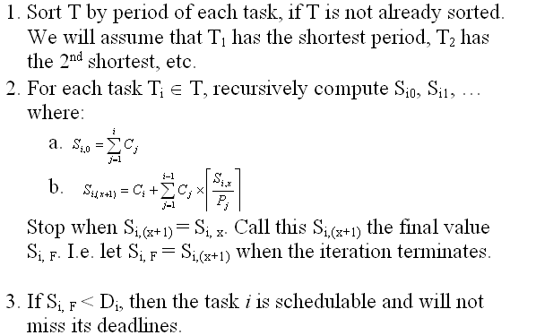
Critical Instance Analysis

Slide 43
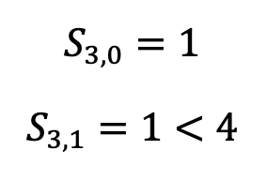
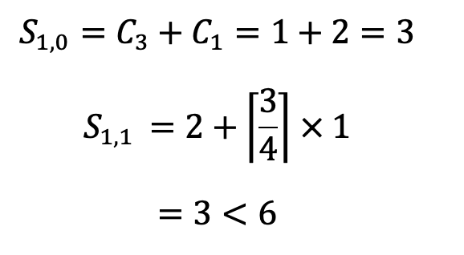
Critical Instance Analysis
RMS Example 1:
    T3 is schedulable.
    T1 is schedulable.

Slide 44
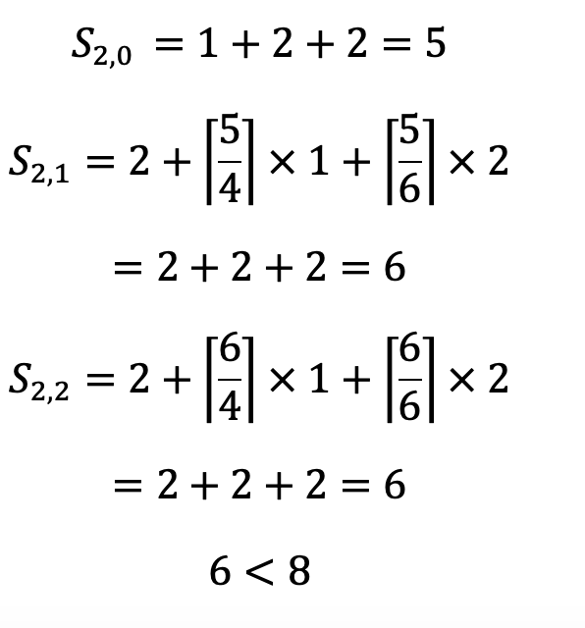
Critical Instance Analysis
RMS Example 1:
    T2 is schedulable.
Since T3, T1 and T2 are schedulable, all will meet their deadlines.

Slide 45
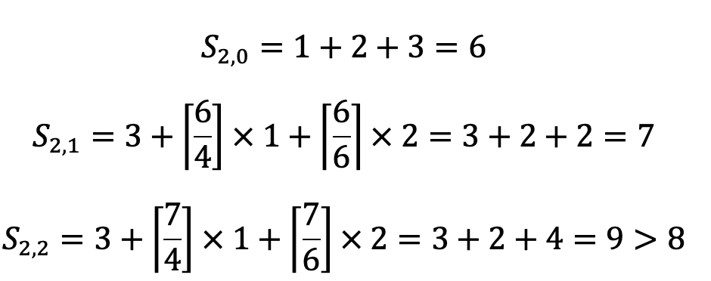
Critical Instance Analysis
RMS Example 2
  T3 and T1 are the same as before, so we will only work on T2.
    We see that T2 is not schedulable.

Slide 46
Earliest Deadline First
RMS is a fixed priority scheme:
  Issue: Even as we approach the deadline of a task, it can be pre-empted by higher priority tasks.
  What if we change the schedule so that as a task approaches its deadline, its priority is upgraded?
This is Earliest Deadline First (EDF) scheduling.

Slide 47
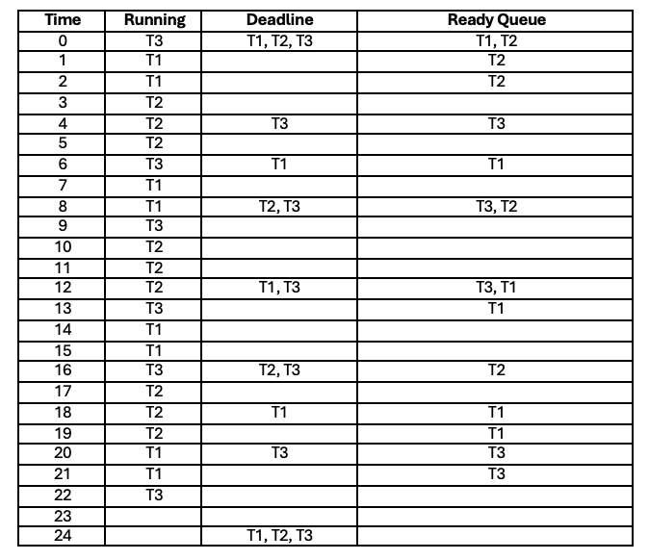
EDF Example
Let’s consider RMS Example 2, but scheduled it under EDF instead.

Slide 48
Summary
Scheduling in OS:
  Basic definition
  Factors that affect scheduling
    Process, Environment
  Criteria of good scheduling
Scheduling Algorithms:
  RR, Priority scheduling for Interactive System
  Priority, RMS and EDF scheduling for Real Time Systems.

Slide 49
Reference
Modern Operating System (3rd Edition)
  Chapter 2.4
Operating System Concepts (7th Edition)
  Chapter 5
Operating Systems: Three Easy Pieces
  By Arpaci-Dusseau and Arpaci-Dusseau
  http://pages.cs.wisc.edu/~remzi/OSTEP/

